Slide 1

Learnbay
Machine Learning Project
Bank Customer Churn Prediction
By – Tarique Anwar
11th April 2025

Slide 2
Project Overview:
1
This project focuses on predicting customer churn in the banking sector using demographic and financial data.
It aims to uncover key factors driving customer exits and identify high-risk segments.
The insights help design targeted strategies to improve customer retention and loyalty
2
3

Slide 3

Data Overview:
1
Data Size
10000 Rows and 13 Features
Key Features
CustomerId, Surname, CreditScore, Geography, Gender, Age, Tenure, Balance, NumOfProducts, HasCrCard, IsActiveMember, EstimatedSalary, Exited.
Target Variable
Exited (1=Yes, 0=No)
2
3

Slide 4
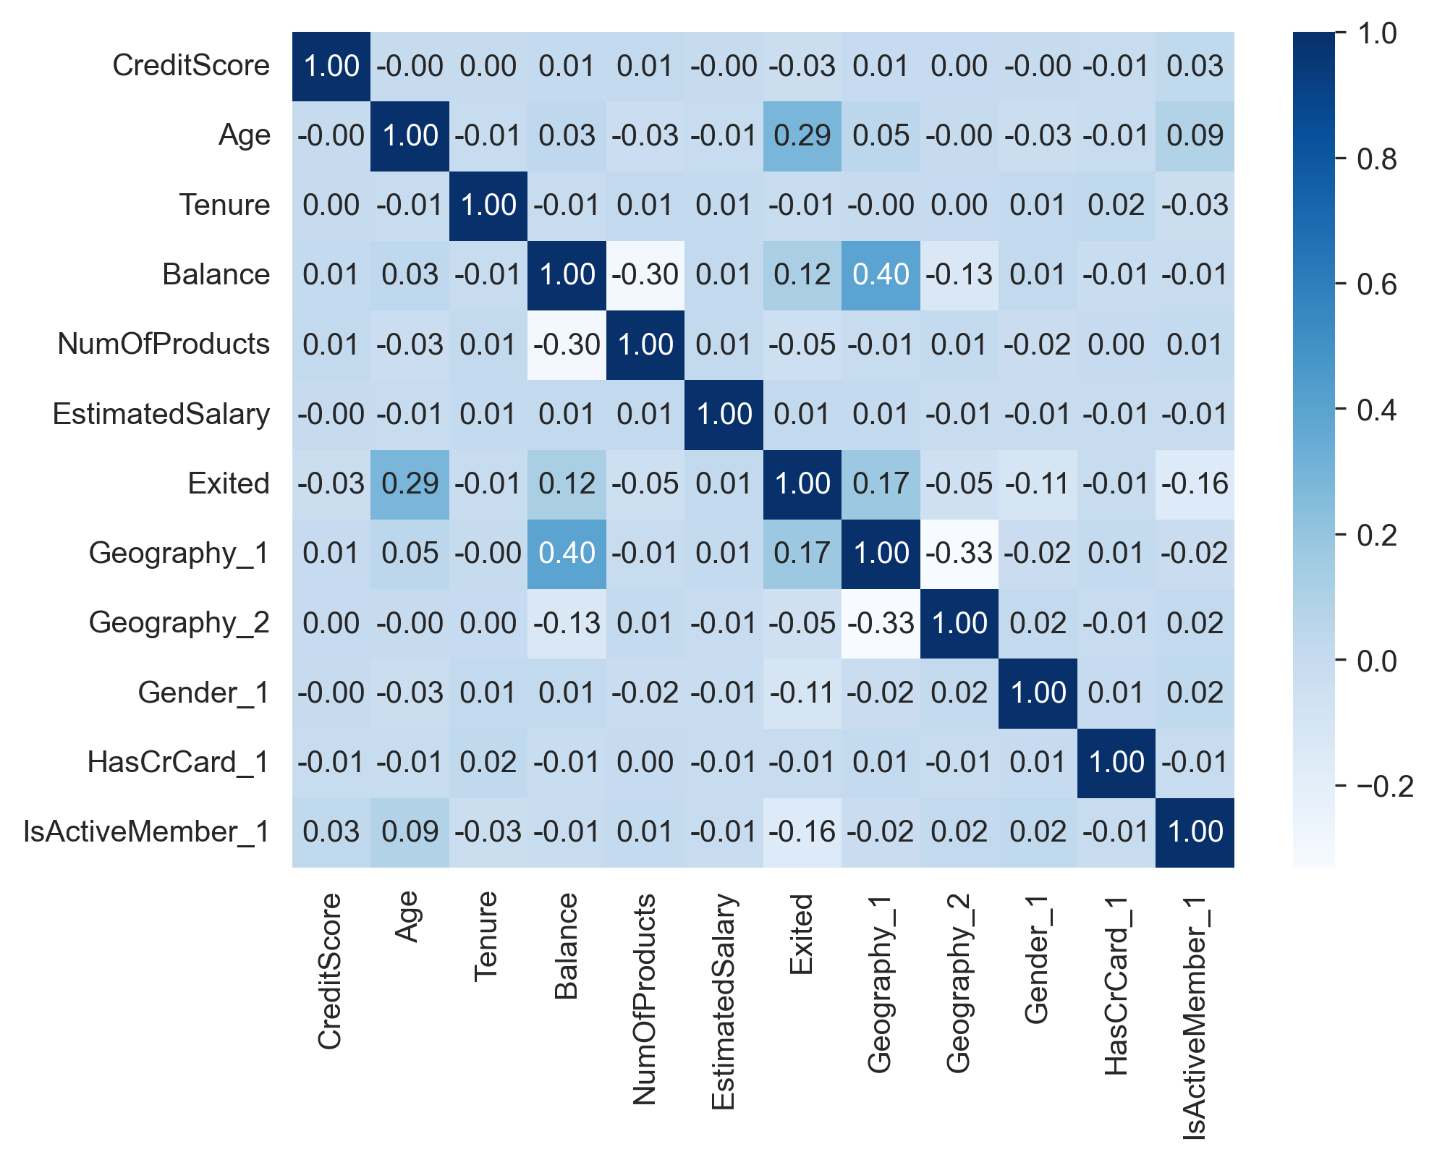
Exploratory Data Analysis:
Correlation Analysis
Heatmap revealed relationships between variables, guiding feature selection.

Slide 5
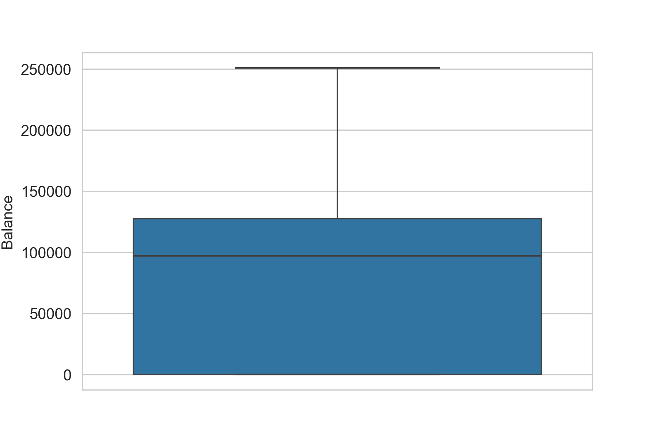
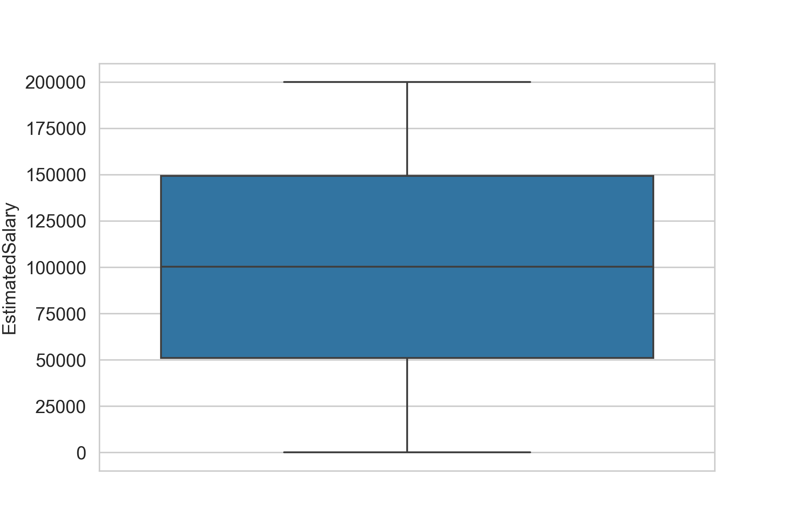
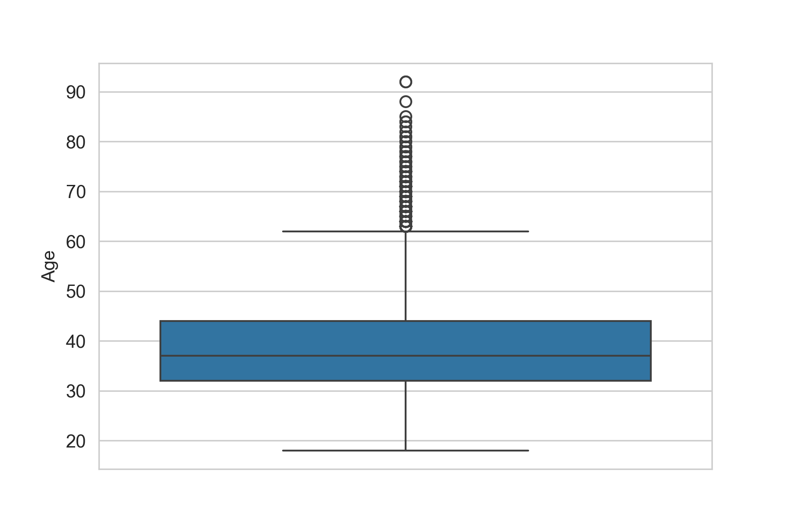
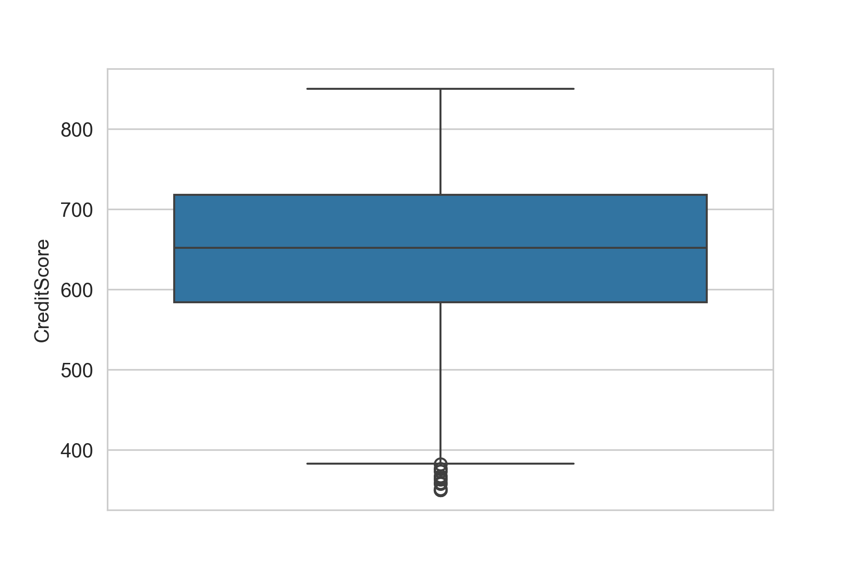
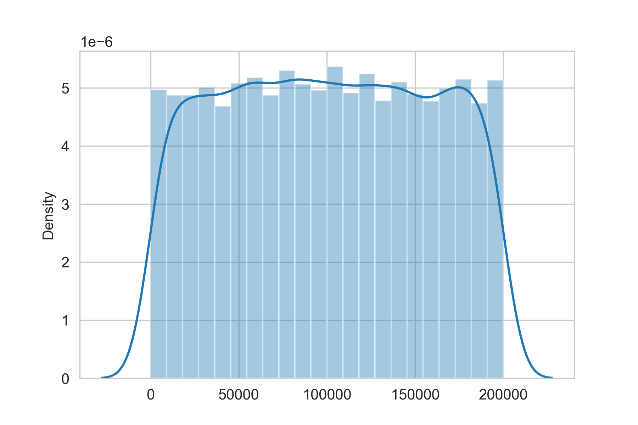
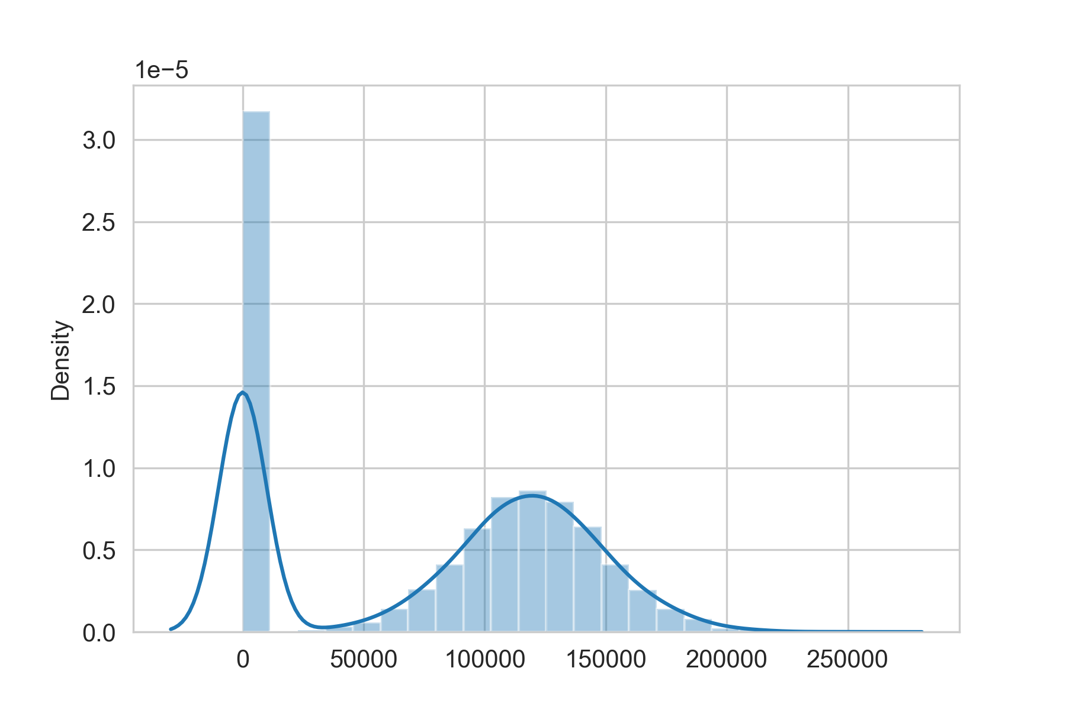
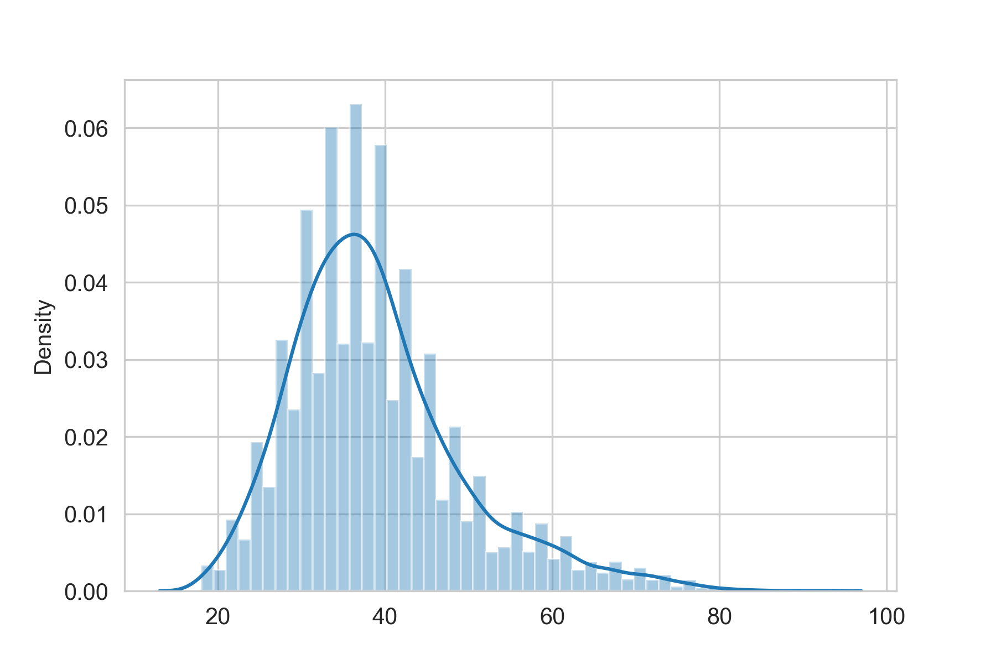
Exploratory Data Analysis:
Distribution Plots
Histograms showed data distributions, helping identify potential issues.

Slide 6
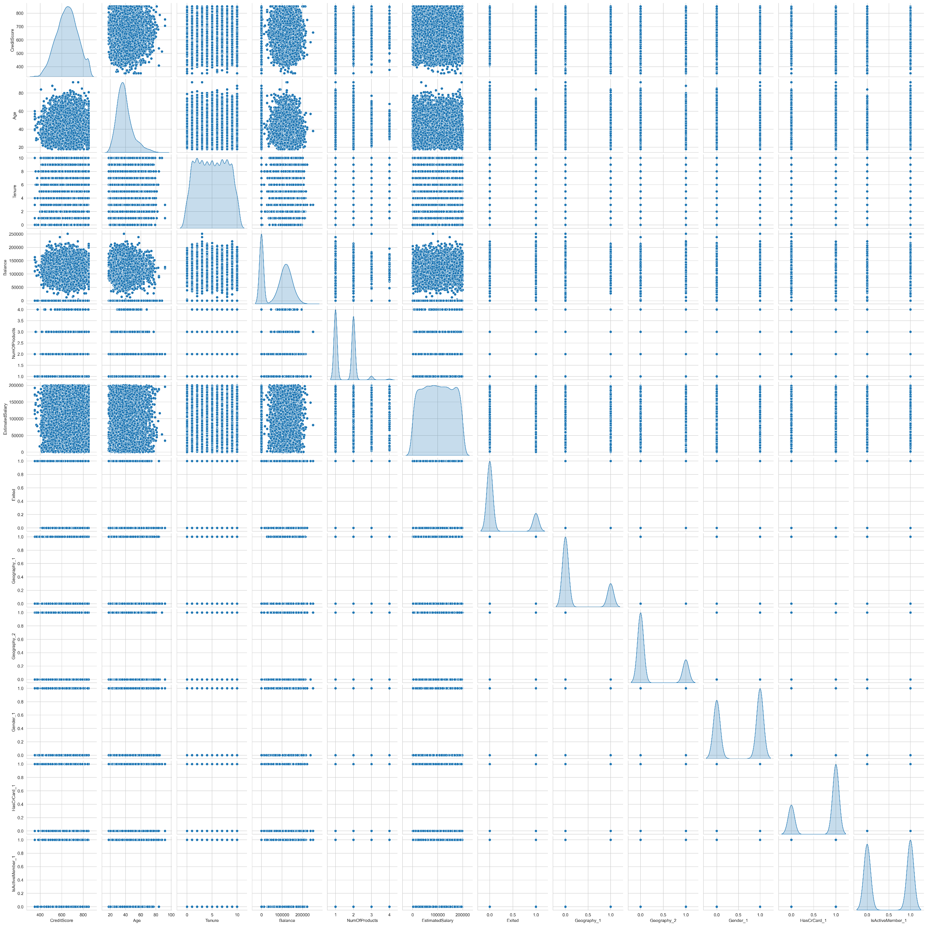
Exploratory Data Analysis:
Scatter Plots
Pairwise scatter plots highlighted relationships between features and target variable.

Slide 7
Data Preprocessing:
1
Data Cleaning
Dropping irrelevant columns (CustomerId, Surname)
Encoding Categorical Variables
Geography -- {France:0, Spain:1, Germany:2}
Gender -- {Male:0, Female:1}
Feature Engineering
One Hot Encoding (Geography, Gender, HasCrCard, IsActiveMember)
Segregating the Target and Predictor Variables
X = Target-variables, y = Predictor-variables
2
3
4

Slide 8
Data Preprocessing
5
Splitting dataset into train and test
80% = Training-data, 20% = Test-data
Scaling the data using RobustScaler
X_train_scaled, X_test_scaled
Applying PCA
PCA(0.95) – Selecting features contributing 95%
Balancing the data
Resampling using SMOTE technique to increase minority class.
6
7
8

Slide 9
Model Selection
Linear Models
K-Nearest Neighbors
Logistic Regression for modeling linear relationships in classification tasks
K-Nearest Neighbors (KNN) for capturing non-linear patterns based on neighborhood similarity
1
2
3
4
Tree Based Models
Advance ML Models
Decision Tree and Random Forest for capturing non-linear relationship.
XGBoost Classifier for efficient and accurate modeling using gradient boosting on decision trees

Slide 10
Model Training and Evaluation
Data Splitting
Performance Metrics
80% training, 20% testing split for model evaluation.
Evaluated models using Accuracy_Score, Precision, Recall, and F1-Score.
1
2
3
Hyperparameter Tuning
Used RandomizedSearchCV to optimize model parameters.

Slide 11
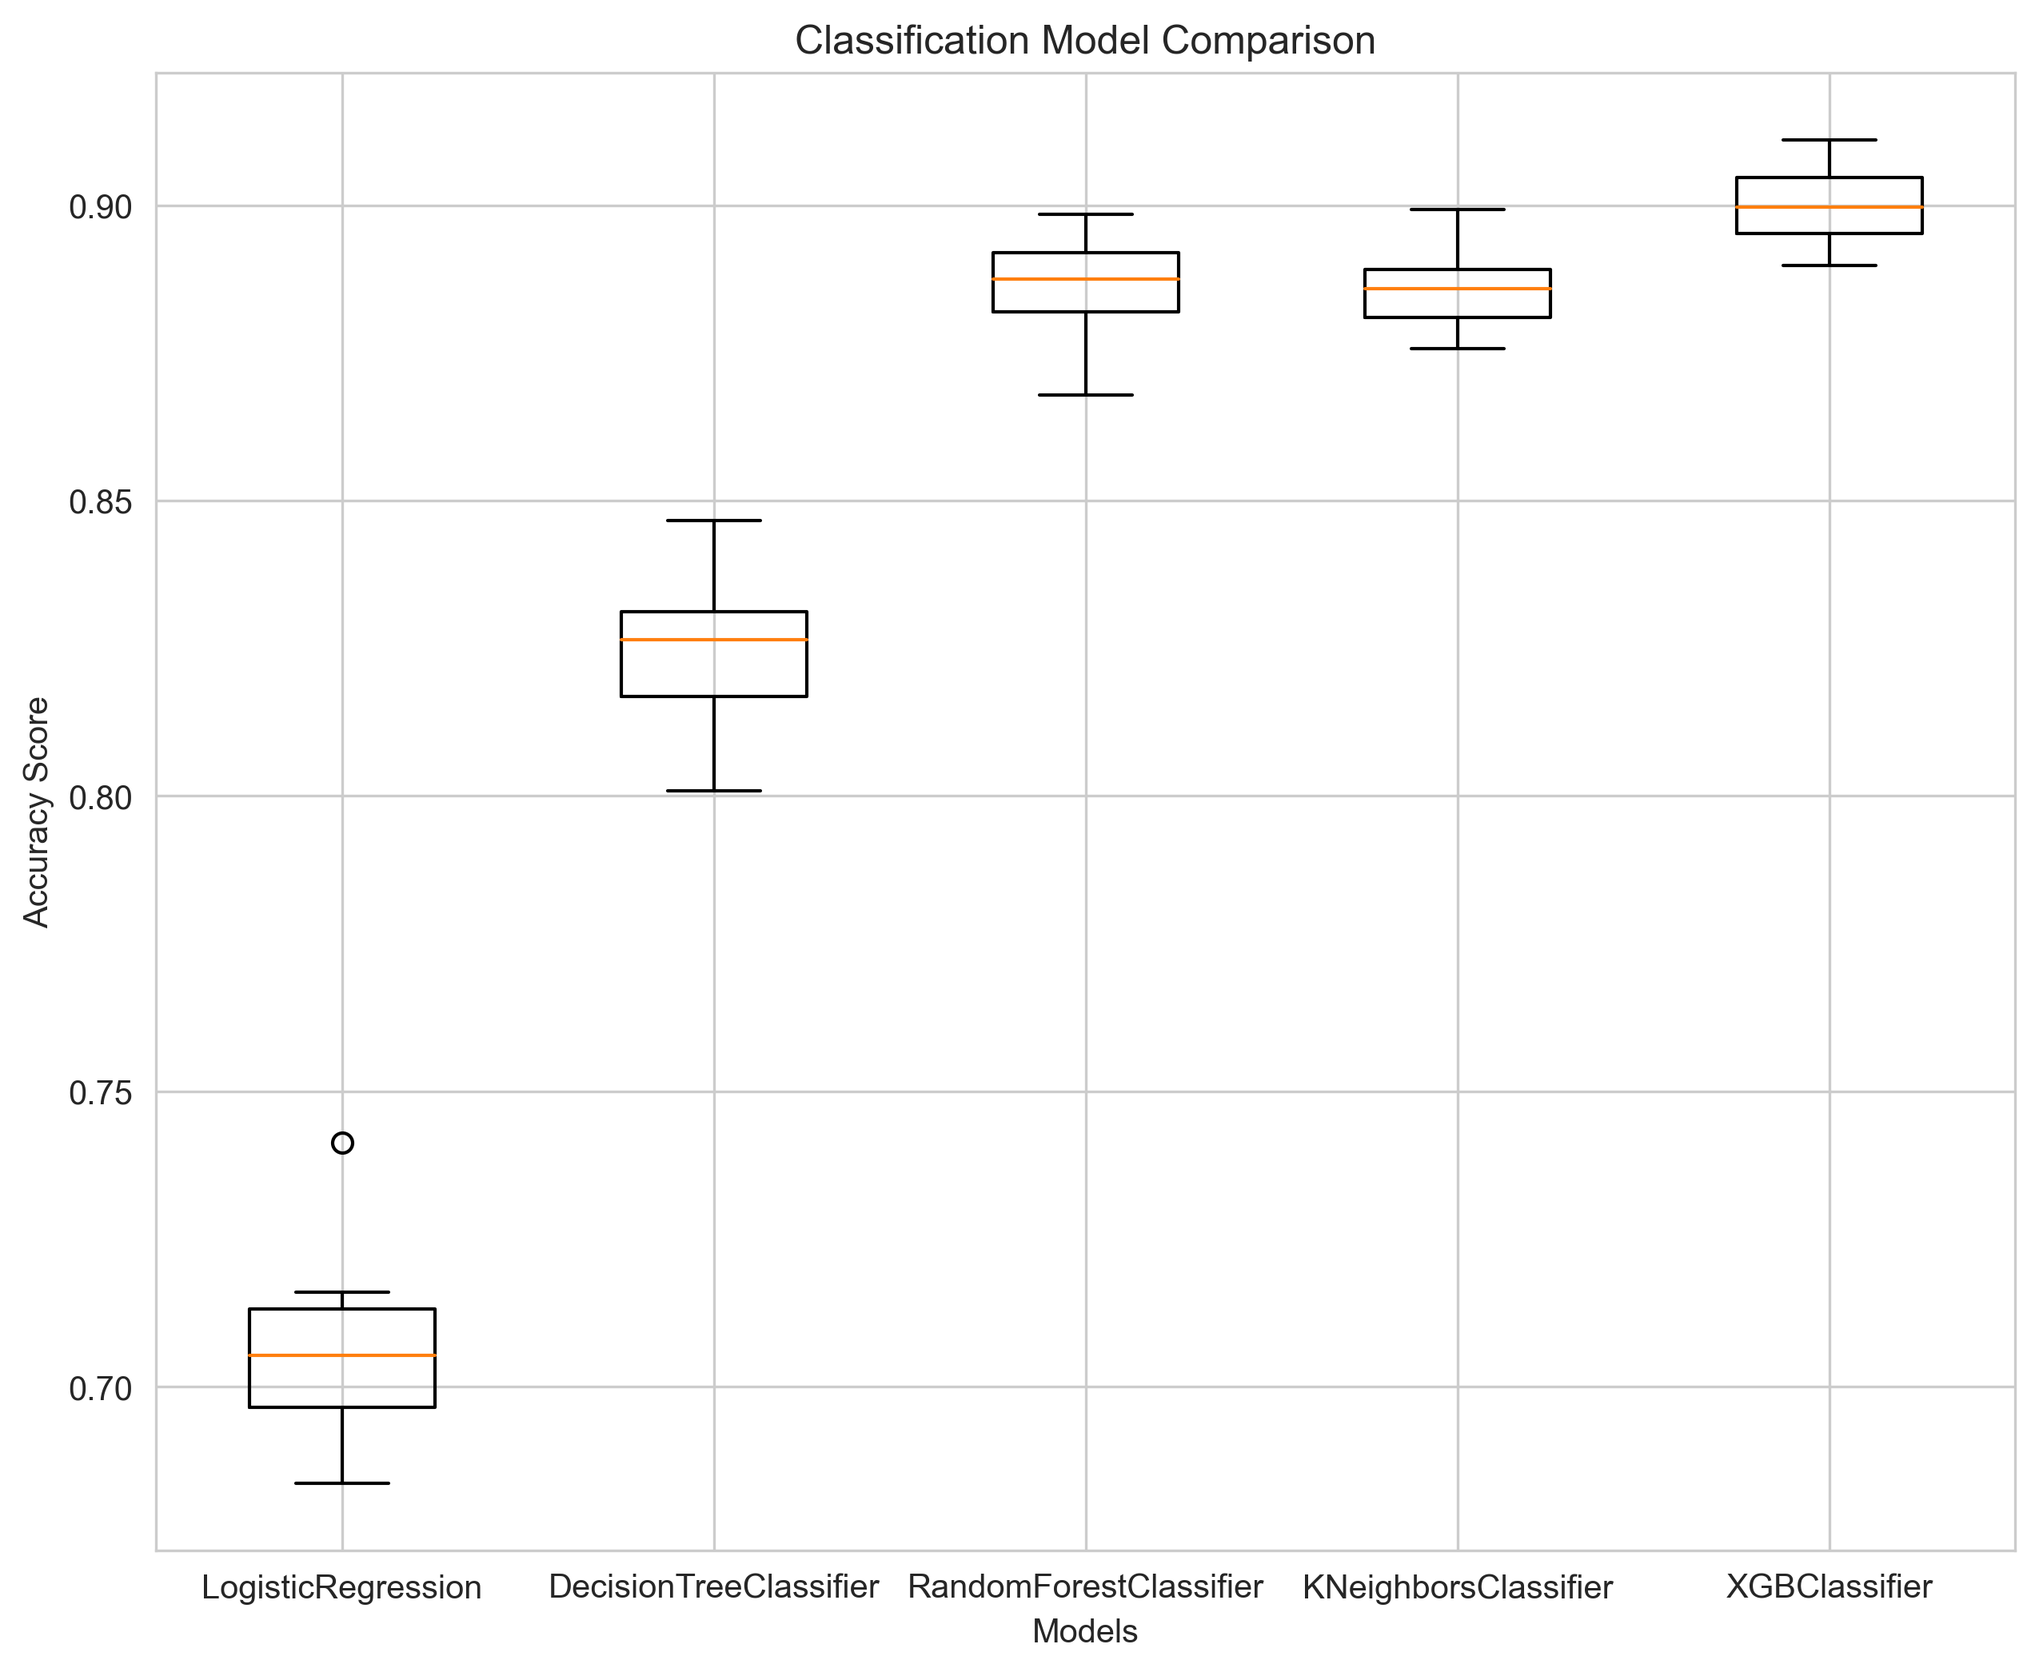
Model Performance Comparison
1
Best Performer
XG-Boost Classifier achieved the highest with accuracy of 0.8999
Runner-up
Random Forest Classifier came second with accuracy of 0.8870
Baseline
Logistic Regression came last with accuracy 0.70
2
3

Slide 12
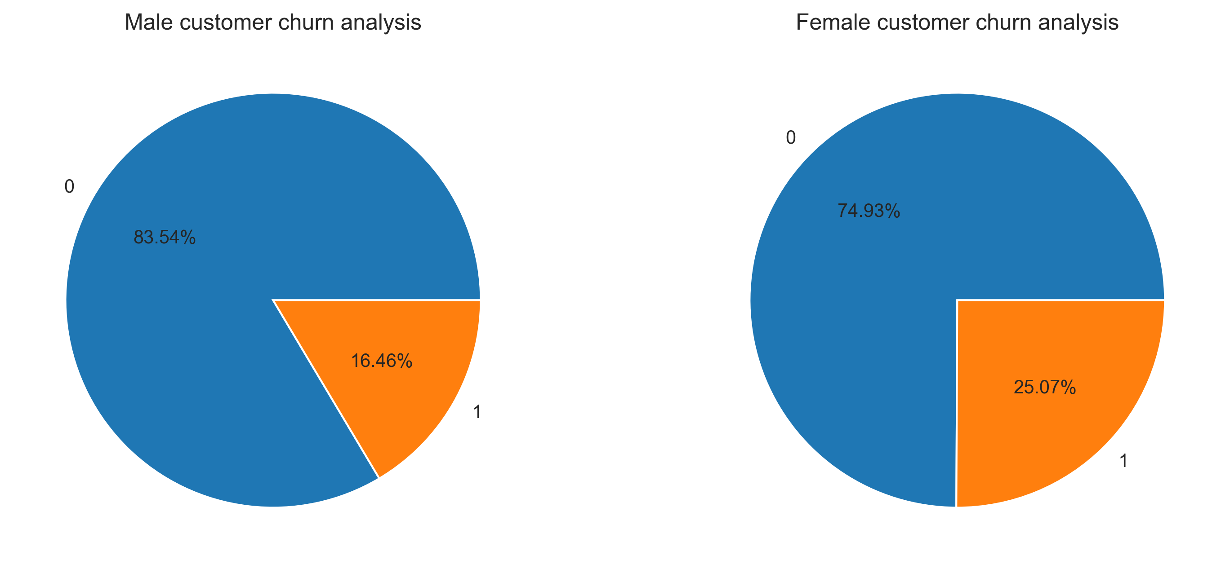
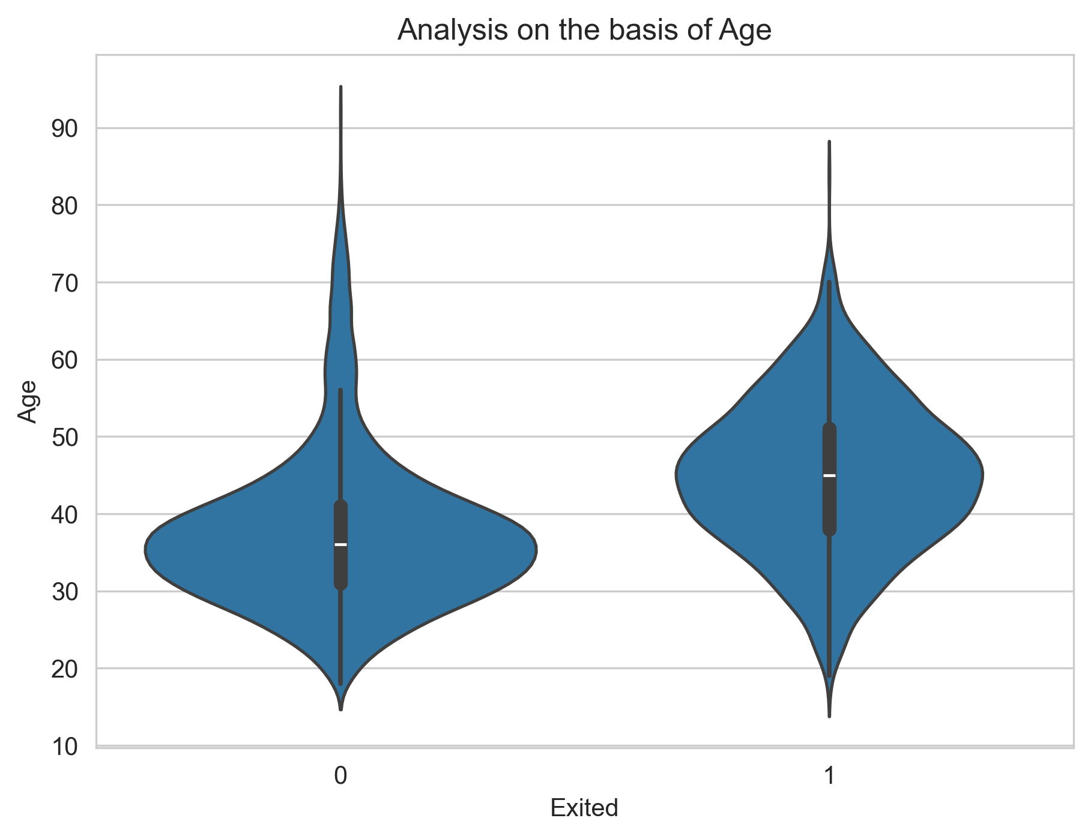
Key Findings
1
Female customers exhibit a higher churn rate compared to male customers.
The age group of 40 to 50 years shows the highest likelihood of customer churn.
2

Slide 13
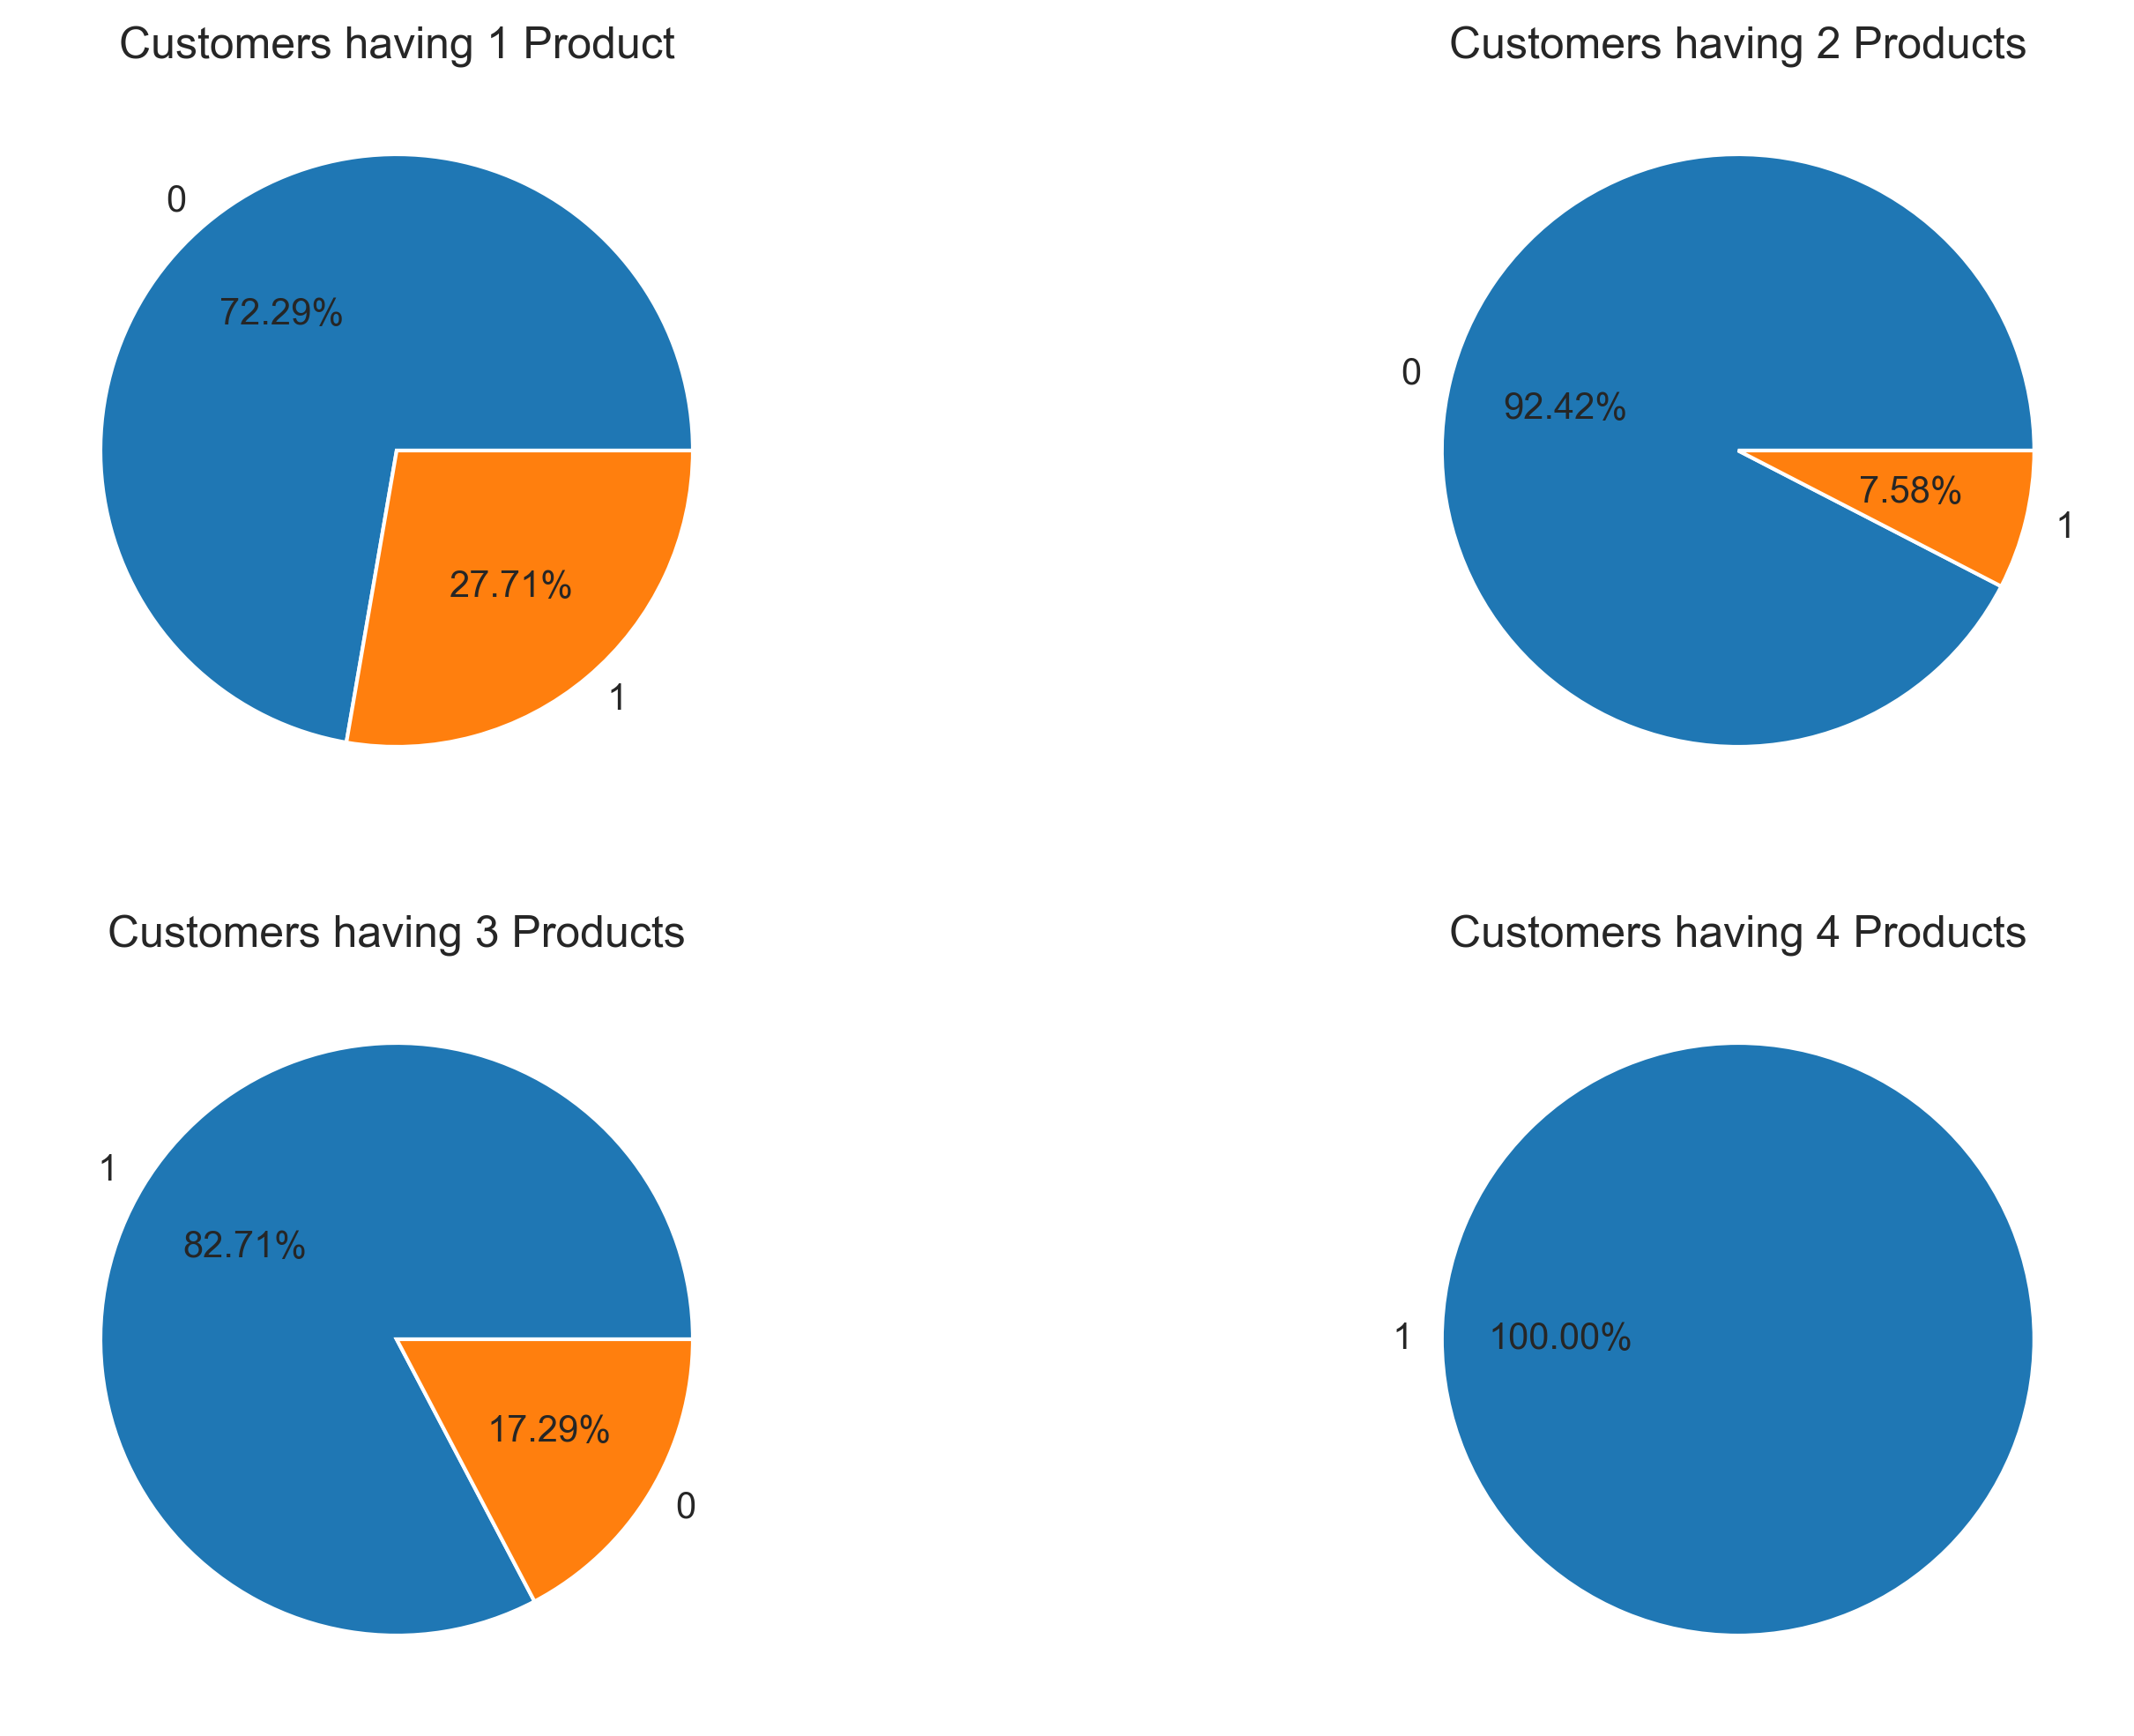
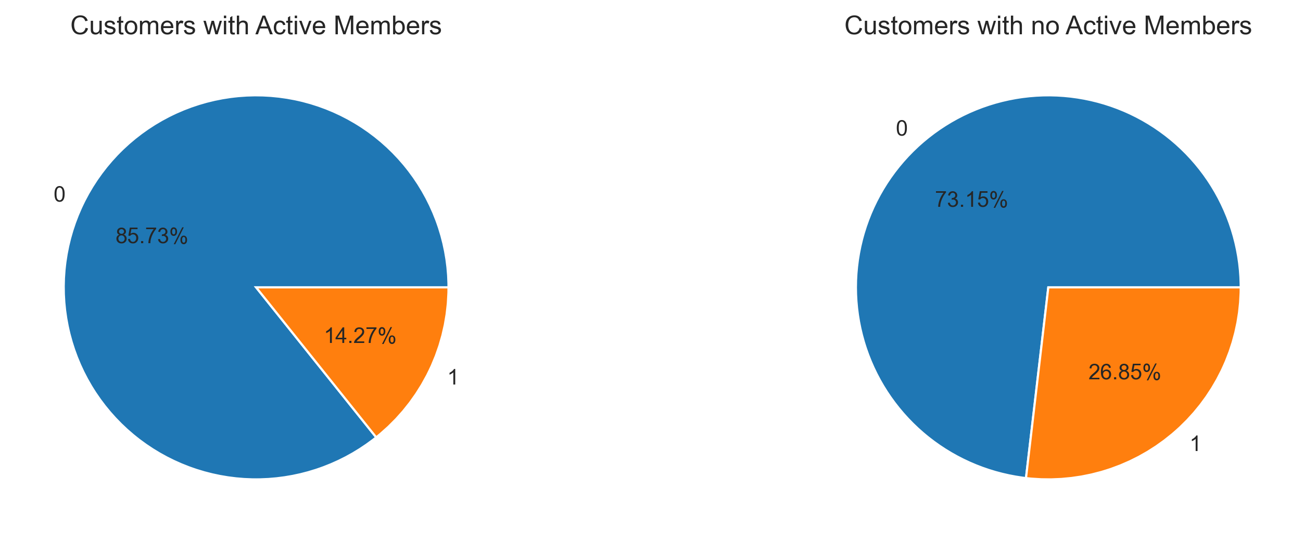
Key Findings
3
Holding one product are more likely to leave the bank.
A significant churn rate of approximately 25% is observed among customers who are not active members
4

Slide 14
Recommendation:
1
Develop Targeted Retention Strategies for Female Customers
Personalized engagement campaigns, loyalty programs, or feedback initiatives specifically tailored to their preferences and concerns.
Implement Proactive Outreach for Customers Aged 40–50
Providing financial planning support, customized product bundles, or exclusive offers may improve retention.
Monitor and Support Customers with Mid-Range Balances (₹100,000–₹150,000)
Introduce incentives such as higher interest rates on savings, free advisory services, or tiered benefits to increase their satisfaction and loyalty.
2
3

Slide 15
Recommendation:
4
Encourage Product Adoption Through Cross-Selling
As single-product customers are more likely to churn, promote additional products (e.g., insurance, investment services, credit cards) through cross-selling campaigns and bundled offerings to increase stickiness.
Enhance Engagement with Inactive Members
With a churn rate of ~25% among inactive members, prioritize re-engagement strategies such as personalized communication, app usage nudges, or rewards for activity to reactivate their relationship with the bank.
5

Slide 16
Thank You

